Slide 1
Information Retrieval
Architecture, Boolean Model and Vector Space Model.

Slide 2
Types of Information
Text
XML and structured documents
Images
Audio
Video
Source Code
Applications/Web services

Slide 3
Information Retrieval
Retrieval
“Fetch something” that’s been stored
Information Retrieval - Calvin Mooers definition
“Information retrieval is a field concerned with the structure, analysis, organization, storage, searching, and retrieval of information.” It is the activity of obtaining information resources relevant to an information need from a collection of information resources.
Main objective of IR
Provide the users with effective access to and interaction with information resources.
Goal of IR
The goal is to search large document collections to retrieve small subsets relevant to the user’s information need.

Slide 4
Information Retrieval vs Information Extraction
Extraction means “pulling out” and Retrieval means “getting back.”
Information retrieval is about returning the information that is relevant for a specific query or field of interest of the user.
While information extraction is more about extracting general knowledge (or relations) from a set of documents or information.
Information extraction is the standard process of taking data and extracting structured information from it so that it can be used for various purposes, one of which may be in a search engine.

Slide 5
 | Information Retrieval | Information Extraction
1. | Document Retrieval | Feature Retrieval
2. | Return set of relevant documents | Return facts out of documents
3. | The goal is to find documents that are relevant to the user’s information need | The goal is to extract pre-specified features from documents or display information.
4. | Real information is buried inside documents | Extract information from within the documents
5. | The long listing of documents | Aggregate over the entire set
6. | Used in many search engines – Google is the best IR system for the web. | Used in database systems to enter extracted features automatically.
7. | Typically uses a bag of words model of the source text. | Typically based on some form of semantic analysis of the source text.
8. | Mostly use the theory of information, probability, and statistics. | Emerged from research into rule-based systems.

Slide 6
Data Retrieval vs Information Retrieval
Parameters | Databases/ Data Retrieval | Information Retrieval
Example | Database Query | WWW search
What are we retrieving | Structured data | Mostly unstructured data
Queries we are posing | Formally defined queries, unambiguous | Expressed in a natural language
Matching | Exact | Partial match, best match
Inference | Deduction | Induction
Model | Deterministic | Probabilistic

Slide 7
Information Retrieval
Information retrieval is defined as the process of accessing and retrieving the most appropriate information from text based on a particular query given by the user, with the help of context-based indexing or metadata.
Google Search is the most famous example of information retrieval.
An information retrieval system searches a collection of natural language documents with the goal of retrieving exactly the set of documents that matches a user’s question. They have their origin in library systems.
These systems assist users in finding the information they require but it does not attempt to deduce or generate answers. It tells about the existence and location of documents that might consist of the required information that is given to the user.
The documents that satisfy the user’s requirement are called relevant documents. If we have a perfect IR system, then it will retrieve only relevant documents.

Slide 8
Information Retrieval
In information retrieval and text analysis, solving problems is a vital part of finding the correct information from extensive collections of papers quickly and effectively.
The Boolean and Vector Space Models are well-known models that offer different ways to solve problems.
To improve knowledge retrieval processes, it is essential to understand these models and how they solve problems.

Slide 9
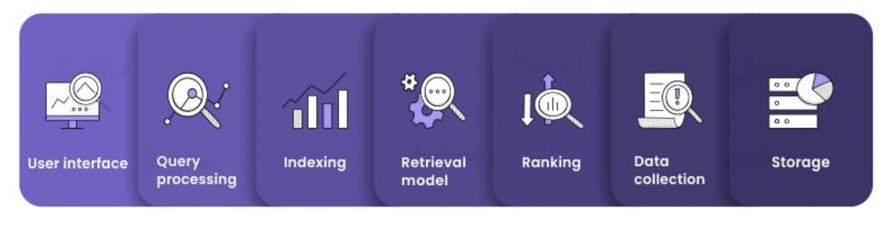
Architecture of Information Retrieval System
The architecture of an IR system typically includes the following components:
User interface: This component enables user interaction with the system. Filters, search box, and other tools may be included in it so that the users may input their queries and hone the search results.
Query processing: The query processing component transforms processed user queries into a form that may be utilized to search the index. The parsing, expansion, and rewriting of queries are just a few examples of its possible sub-components.
Indexing: Making an index of the document collection is the indexing component’s responsibility. All the terms involved in the document collection are normally listed in this index, together with the information about how frequently and where they appear.

Slide 10
Architecture of Information Retrieval System
Retrieval model: In order to obtain and rank documents in response to a user query, the retrieval model must be used. Boolean, vector-space, and probabilistic models are only a few of the various retrieval models available.
Ranking: The ranking element chooses the order in which the pages are displayed to the user, depending on how relevant they are to the query. A relevance score is generally calculated for each document by the ranking component using the retrieval model, and the documents are then sorted according to the score.
Data collection: A document collection is a set of papers that must be searched. It may include a variety of sources, including written materials like books, journals, and websites.
Storage: The document collection, index, and other data that the system requires to execute searches and retrievals are held in the component that handles storage.

Slide 11

Use cases of Information Retrieval
Web Search:
Web search is the most typical application of IR. In order to gather and display consumers with pertinent information, depending on their queries, search engines like Google and Bing employ IR methods.
E-commerce:
To assist customers in finding things that they are interested in, online marketplaces like Amazon and eBay employ IR. In order to rank items, according to their relevance, IR methods are employed to search for and retrieve product information, based on user queries.
Healthcare:
IR is employed by the healthcare industry to locate pertinent medical data in databases and electronic health records. Doctors and researchers who need to make judgments about their patient’s care and treatment methods can use this knowledge to their advantage.

Slide 12
Use cases of Information Retrieval
Legal research:
To find and retrieve pertinent case laws, legal papers, and other legal material, attorneys and other legal professionals utilize IR.
News and media:
To find and retrieve pertinent news items and other media material, news organizations employ IR. This enables them to stay up to date on current affairs and give their audience correct information at the appropriate moment.

Slide 13
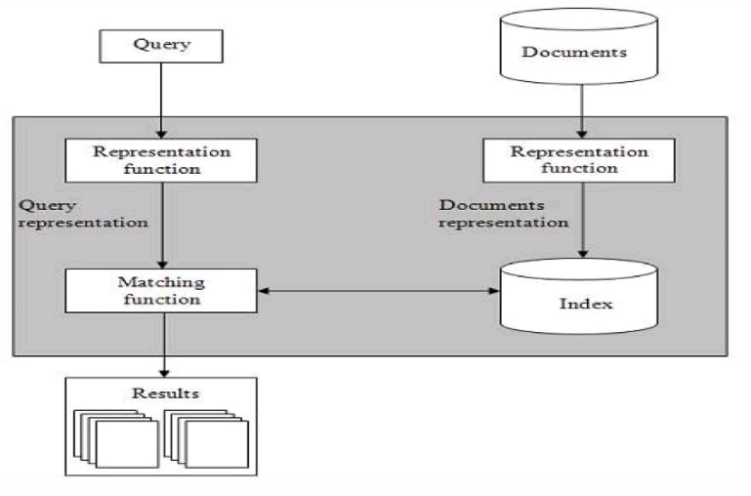
Basics of IR Systems

Slide 14
Basics of IR Systems
From the above diagram, it is clear that a user who needs information will have to formulate a request in the form of a query in natural language. After that, the IR system will return output by retrieving the relevant output, in the form of documents, about the required information.
The step by step procedure of these systems are as follows:
Indexing the collection of documents.
Transforming the query in the same way as the document content is represented.
Comparing the description of each document with that of the query.
Listing the results in order of relevancy.
Retrieval Systems consist of mainly two processes:
Indexing
Matching

Slide 15
Indexing
It is the process of selecting terms to represent a text.
Indexing involves:
Tokenization of string
Removing frequent words
Stemming
Two common Indexing Techniques:
Boolean Model
Vector space model

Slide 16
Matching
It is the process of finding a measure of similarity between two text representations.
The relevance of a document is computed based on the following parameters:
1. TF: It stands for Term Frequency which is simply the number of times a given term appears in that document.
TF (i, j) = (count of i^{th} term in j^{th} document)/(total terms in j^{th} document)
2. IDF: It stands for Inverse Document Frequency which is a measure of the general importance of the term.
IDF (i) = (total no. of documents)/(no. of documents containing i^{th} term)
3. TF-IDF Score (i, j) = TF * IDF

Slide 17
Matching
It is the process of finding a measure of similarity between two text representations.
The relevance of a document is computed based on the following parameters:
1. TF: It stands for Term Frequency which is simply the number of times a given term appears in that document.
TF (i, j) = (count of i^{th} term in j^{th} document)/(total terms in j^{th} document)
2. IDF: It stands for Inverse Document Frequency which is a measure of the general importance of the term.
IDF (i) = (total no. of documents)/(no. of documents containing i^{th} term)
3. TF-IDF Score (i, j) = TF * IDF

Slide 18
Classical Problem in IR Systems
The main aim behind IR research is to develop a model for retrieving information from the repositories of documents. Ad-hoc retrieval problem is the classical problem in IR systems.
Now, let’s discuss what exactly is ad-hoc retrieval?
In ad-hoc retrieval, the user must have to enter a query in natural language that describes the required information. Then the IR system will return the output as the required documents that are related to the desired information.
For Example, suppose we are searching for something on the Internet and it gives some exact pages that are relevant as per our requirement but there can be some non-relevant pages too. This is due to the ad-hoc retrieval problem.

Slide 19
Aspects of Ad-hoc Retrieval
The aspects of ad-hoc retrieval that are addressed in IR research are as follows:
How users with the help of relevant feedback can improve the original formulation of a query?
How to implement database merging, i.e., how results from different text databases can be merged into one result set?
How to handle partly corrupted data? Which models are appropriate for the same?

Slide 20
Information Retrieval Models
Information retrieval models predict and explain what a user will find in relevance to the given query. These are basically a pattern that defines the above-mentioned aspects of retrieval procedure that we discussed in ad-hoc retrieval and consists of the following:
A model for documents.
A model for queries.
A matching function that compares queries to documents.
Mathematically, a retrieval model consists of the following components:
D: Representation for documents.
Q: Representation for queries.
F: The modeling framework for D, Q along with the relationship between them.
R (q, di): A ranking or similarity function that orders the documents with respect to the query.

Slide 21
Types of IR Model
The following are three models that are classified for the Information model (IR) model:
Classical IR Models
These are the simplest and easy-to-implement IR models. These are based on mathematical knowledge that was easily recognized and understood as well.
Following are the examples of classical IR models:
Boolean models,
Vector models,
Probabilistic models.

Slide 22
Types of IR Model
Non-Classical IR Models
These are completely opposite to the classical IR models. These are based on principles other than similarity, probability, Boolean operations.
Following are the examples of Non-classical IR models:
Information logic models,
Situation theory models,
Interaction models.

Slide 23
Types of IR Model
Alternative IR Models
It is the enhancement of the classical IR model that makes use of some specific techniques from some other fields.
Following are the examples of Alternative IR models:
Cluster models,
Fuzzy models,
Latent Semantic Indexing (LSI) models.

Slide 24
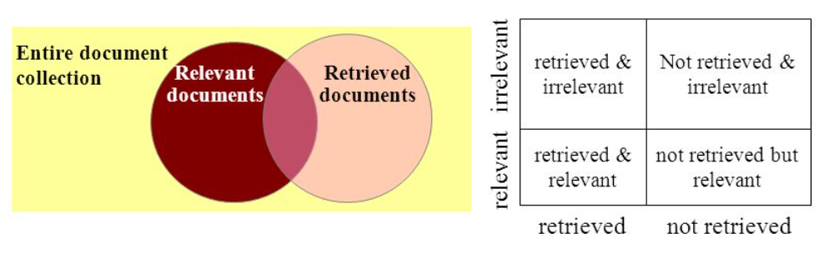
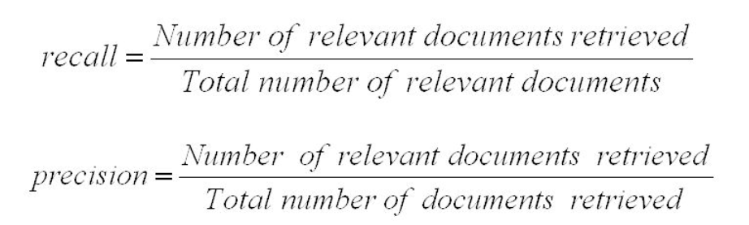
Evaluation of IR Systems
The two common effective measures for evaluating IR systems are as follows:
Precision
Recall
Precision: Precision is the proportion of retrieved documents that are relevant.
Recall: The recall is the proportion of relevant documents that are retrieved.
Ideally both precision and recall should be 1. In practice, these are inversely related.

Slide 25
Boolean Model
The Boolean Model is a way to find information. It is based on Boolean logic about true and false numbers.
This model shows documents and queries as sets of terms, where each term can be present (true) or missing (false).
Users can build complex queries using logical operators (AND, OR, NOT) to retrieve relevant documents.
Example
Let's say we have a collection of papers about animals, and we want to find the ones that include both "cat" and "dog." With the help of the Boolean Model, we make a query: "cat AND dog." Only papers with both "cat" and "dog" are returned by the model.

Slide 26
Boolean Model: Advantages
Precise Retrieval − The Boolean Model lets you match terms exactly, so you can find papers that meet specific criteria quickly and precisely. Boolean model is very helpful in situations where accuracy is very important, like legal study or scientific research.
Control Over Retrieval − Users have fine-grained control over the retrieval process because they can use logical operators to build complex searches. They can combine multiple terms and say how they relate to each other, ensuring that the papers they find meet certain criteria.
Straight-Forward and Easy − The rules of Boolean reasoning that the Boolean Model is based on are easy to understand and use. It doesn't need complicated math calculations or formulas, so even people who know little about technology can use it.

Slide 27
Boolean Model: Advantages
It is the simplest model based on sets.
It is easy to understand and implement.
It only retrieves exact matches.
It gives the user, a sense of control over the system.

Slide 28
Boolean Model: Disadvantages
Lack of Importance of Terms − The Boolean Model treats all terms the same without considering how important or relevant they are. This means that papers that might be useful but don't exactly match the query terms could be left out. It can't rank documents in order based on their text.
Complicated Query Construction − Users unfamiliar with Boolean logic may find it hard to put together complicated Boolean queries. It needs a good understanding of logical operators and how to use them, which may stop some people from using the model.

Slide 29
Boolean Model: Disadvantages
The model’s similarity function is Boolean. Hence, there would be no partial matches. This can be annoying for the users.
In this model, the Boolean operator usage has much more influence than a critical word.
The query language is expressive, but it is complicated too.
There is no ranking for retrieved documents by the model.

Slide 30
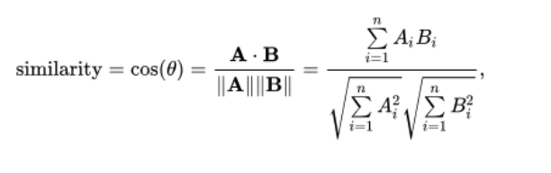
Vector Space Model
As we have seen that there are some limitations in the Boolean model, so we have come up with a new model which is based on Luhn’s similarity criterion, which states that “the more two representations agreed in given elements and their distribution, the higher would be the probability of their representing similar information”.
To understand more about the vector Space model, you have to understand the following points:
1. In this model, the index representations (documents) and the queries are represented by vectors in a T dimensional Euclidean space.
2. T represents the number of distinct terms used in the documents.
3. Each axis corresponds to one term.
4. Ranked list of documents ordered by similarity to the query where the similarity between a query and a document is computed using a metric on the respective vectors.
5. The similarity measure of a document vector to a query vector is usually the cosine of the angle between them.

Slide 31
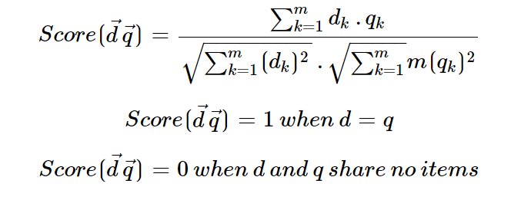
Cosine Similarity Measure Formula
Cosine is a normalized dot product, which can be calculated with the help of the following formula −

Slide 32
Vector Space Model: Advantages
Conceptual Similarity − The Vector Space Model takes into account the semantic connections between terms and documents. This lets it find conceptually similar documents even if they don't have the exact query words. It takes into account the general context and meaning of words, which makes retrieval more complete.
Relevance Ranking − The Vector Space Model ranks documents by how similar they are to the question. This makes it possible to retrieve information based on how relevant it is. It gives term weights by using methods like TF-IDF, which gives more weight to terms that are both useful and rare in the collection of documents. This helps put more relevant papers at the top of the search results.
Flexibility − The Vector Space Model lets you choose how you want to ask questions. Users are not limited to exact matches, and they can get documents that are tied to the query in a contextual or semantic way. Because of this, it can be used for a wide range of information-finding jobs.

Slide 33
Vector Space Model: Disadvantages
Curse of Dimension − In the Vector Space Model, the high dimension of the vector space can make it harder to do computations and take up more room. As the number of unique terms goes up, it gets exponentially harder to understand and compare vectors.
Challenges with Synonymy and Polysemy − The Vector Space Model takes each term as a separate entity, making it hard to deal with synonymy (when different words mean the same thing) and polysemy (when the same word can mean more than one thing). You should use more tools, like semantic analysis or models, to solve these problems well.

Slide 34
Conclusion
In short, the Boolean Model does accurate matching based on whether terms are true or false, while the Vector Space Model focuses on capturing semantic relationships and uses vector representations to figure out how similar documents and queries are.

